Slide 1

Vehicle loan approval system
Introduction to Data Science
CS 842
Presented by :
Dharmik Rampariya
Student id : 200432973
Email id : ddr402@uregina.ca
10, 07, 2020

Slide 2
TABLE OF CONTENT
Introduction
Problem statement
Solution overview
Project components
Data
Tools
Timeline
Expected outcomes

Slide 3
INTRODUCTION
One of the emerging field : Data Science
Purpose: prediction
Techniques and methods
Certain patterns and analysis
Applications

Slide 4
PROBLEM STATEMENT
Lots of loan application received by Bank
Affecting some factors
Possibility of human error
EMI is another point of concern
Data science concepts to solve the problem

Slide 5
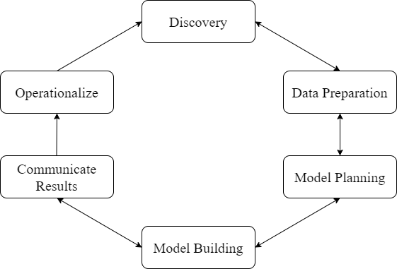
SOLUTION OVERVIEW

Slide 6
Discovery
Data gathering
Resources

Slide 7
Data preparation
Extraction
Cleaning
Transform
Selection

Slide 8
Model Preparation
Classification
    Naïve bayes
    Support vector
    Random forest
Regression
    Support vector
    Random forest
    Logistic regression

Slide 9
Model Evaluation
Confusion matrix
Cross - validation

Slide 10
Communicating results
Building front-end
Integration
Testing
Deployment

Slide 11
Project components
Fully functional website
Web scrapped dataset
Model
Website components :
HTML
CSS
Django
PythonAnywhere

Slide 12
DATA
Source : Rpubs.com
Format : CSV file
Access : Scrapping the dataset
Storage : Web-server
Splitting Data in two parts :
        Training data
        Testing data

Slide 13
Data dictionary
Unique id | An identifier for the customers
Disbursed amount | Amount of loan disbursed
Branch id | Branch where the loan was disbursed.
Employment type | Employment type of customer
Perform CSN score | Bureau score
Pri no of accts | Total number of loans taken by the customer
Pri active accts | Total number of active loans by customer
Credit history length | Time since the first loan

Slide 14
Tools
Python
Pycharm
Numpy
Django
Spyder
Metplotlib
Sci-kit learn
PythonAnywhere

Slide 15
TIMELINE
Task | Start Date | End Date | Duration
Data Gathering | 8/6/2020 | 20/6/2020 | 12 days
Data Cleaning | 23/6/2020 | 30/6/2020 | 8 days
Creating a model | 3/7/2020 | 15/7/2020 | 12 days
Training model | 16/7/2020 | 20/7/2020 | 5 days
Developing front-end | 21/7/2020 | 26/7/2020 | 6 days
Integration of website & model | 27/7/2020 | 1/8/2020 | 6 days
Testing an application | 2/8/2020 | 6/8/2020 | 5 days
Deployment | 7/8/2020 | 10/8/2020 | 4 days

Slide 16
EXPECTED OUTCOME
Fully functional website
Able to predict loan approval
Able to predict EMI

Slide 17
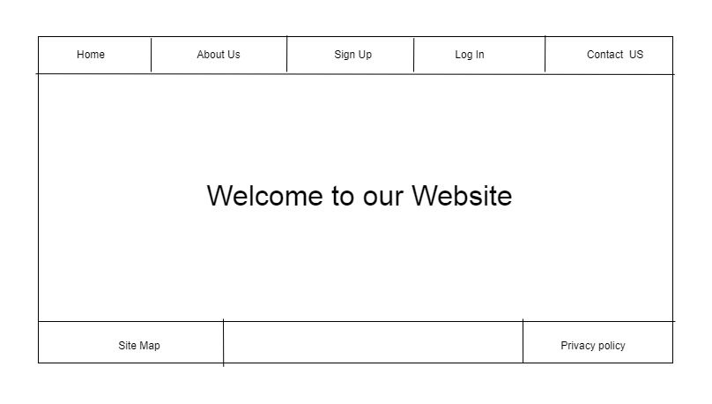
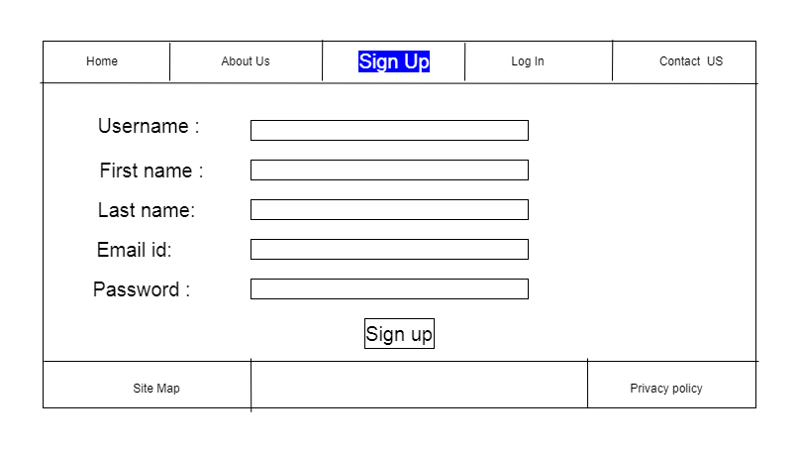
Prototype

Slide 18
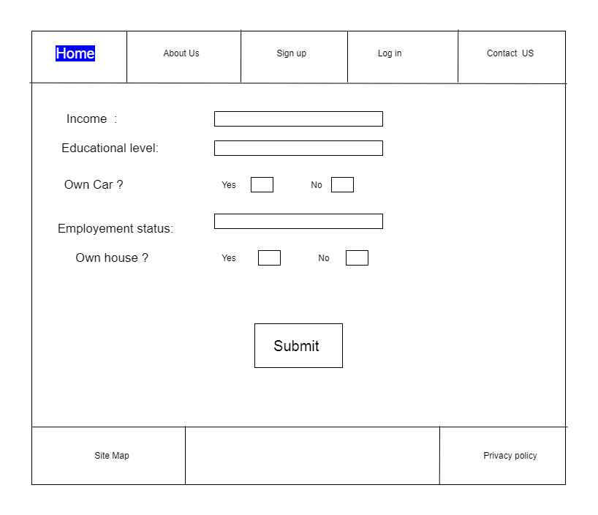
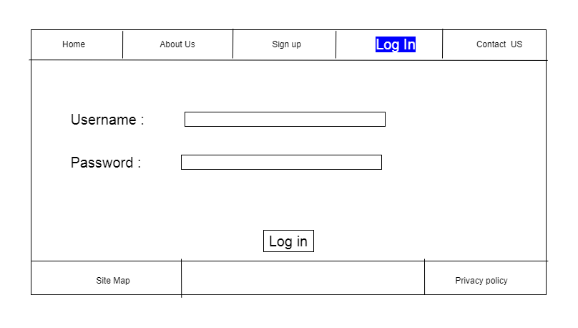
PROTOTYPE

Slide 19
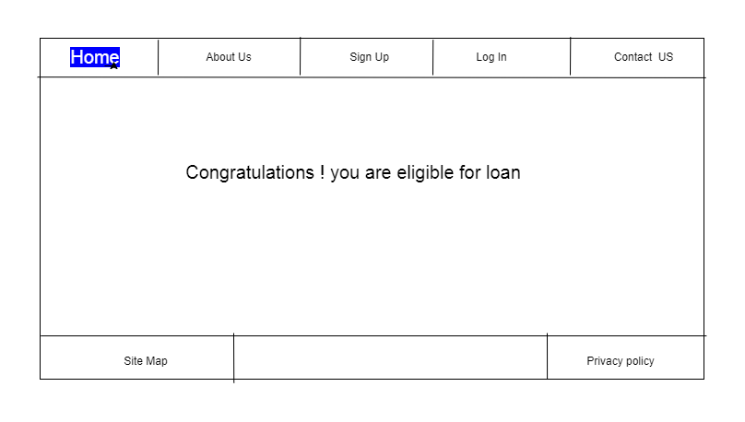
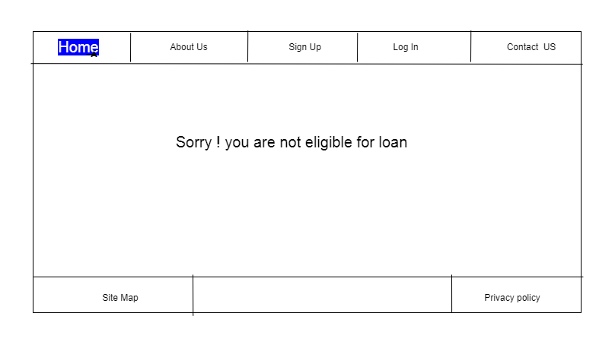
PROTOTYPE

Slide 20
Thank you

